Slide 1
Desktop Clients and Marketing
Channel Overview

Slide 2
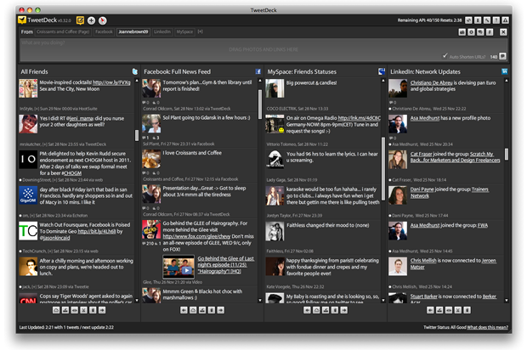
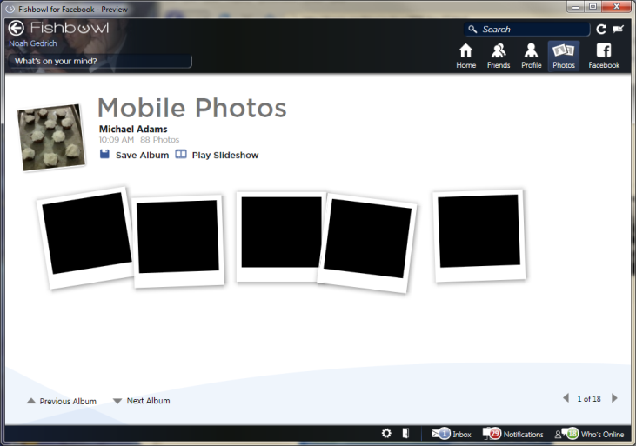
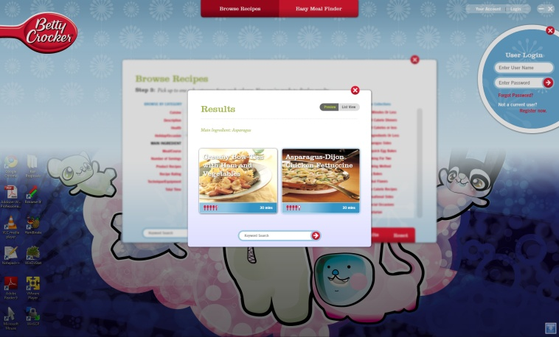
Channel Opportunity
Branded Desktop Applications
Fat Clients are Back
TweetDeck (AIR)
FishBowl (WPF)
Betty Crocker Kitchen Assistant
Virtual Echo
Interacting With Web based Content
Offer Consistent Presence on the Customer Computers
Opportunity for Co-Branding of Content
Opportunity for Offline Storage of Content
Include Reminders and Alerts

Slide 3
Major Technologies
Things BLITZ Knows
Flash Platform
Adobe AIR
mProjector
MDM Zinc
.NET Platform
Microsoft WPF
Microsoft Silverlight
XNA Studio
Unity 3D Platform
Things BLITZ Doesn’t Know
Java Platform
JavaFX
Other UI Frameworks
C Platforms
All the Rest

Slide 4
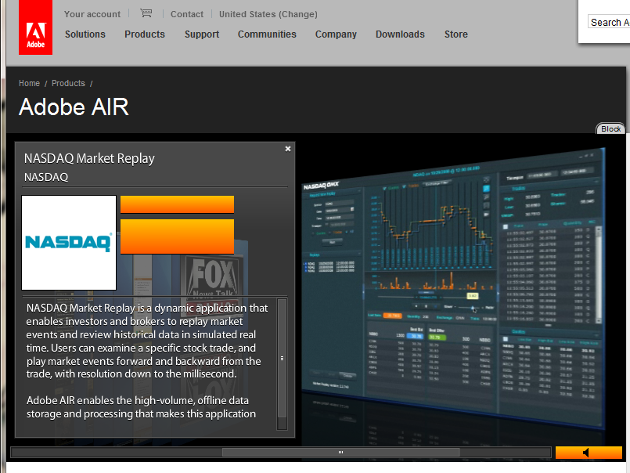
Flash Platform
AIR is Most Useful Wrapper
AIR 2 Features
Cross Platform
Build Once/Deploy Everywhere
All the Visual Capabilities of the Flash/Flex Platform
Mass Storage Access
Network Stack
Multi-Touch
WebKit Browser Included
Access to Command Line (breaks Cross Platform)
AIR 2 Challenges
Not Officially Released Yet
Penetration of AIR runtime is far below Flash Player (MS says 10%)
20-30Mb Install Required
Complicated DRM Strategy
Zinc + mProjector
Basically irrelevant at this point.

Slide 5
Microsoft Platform
WPF
The Good
Full Desktop Application Development
Full 3D Support
XAML Based
Deployable VIA Web
Standard for Windows Software Development Today
The Bad
Windows Only (excluding MONO)
Requires .NET 3 runtime (not standard on XP)
Silverlight
The Good
Cross Platform (OSX + Windows)
Build Once, Deploy Everywhere
Command Line Access
No Additional Install Required
Strong DRM Capabilities
The Bad
Limited Install Base (45% according to MS)
Limited 3D Support
Unfamiliar Toolset

Slide 6
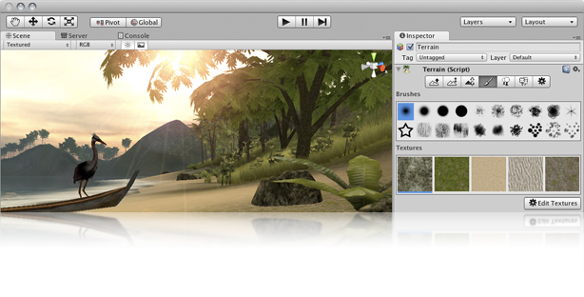
Unity 3d
Almost Exclusively for 3D Games
Code Once, Build for multiple devices
Mac + Windows
Web Deployment
iPhone
WII
Familiar Scripting Languages
C# based on MONO
JavaScript
Python Dialect (Boo)
Great Performance Across Platforms
Challenges
Not really suitable for non-game development
Additional Licensing Cost per Seat for iPhone and WII Development

Slide 7
Thoughts?
What Industries / Clients does the work for?
Almost Any
Any Ideas?
FX Offline Video Distribution
Activision Stats Viewer
Additional Reading
http://labs.blitzagency.com/?p=2254
http://blogs.imediaconnection.com/blog/2008/11/25/the-desktop-is-dead-long-live-the-desktop/

